Slide 1
Introduction to Python
Murad Megjhani

Slide 2
Learning Objectives
1. What is Python
2. Hello World! Working with programming language (may be your first time, its fun)
3. Working with key Data structures (int, float, list, set, tuples, dictionary)
4. Classes Functions
5. Working with Libraries
6. Doing some data analysis (toward the end)
7. Creating your first complete project (optional, but highly recommended)
Notes:
https://slideplayer.com/slide/7102683/

Slide 3
Python Installation
Anaconda ( will include all the major libraries, so no need to install specific library)
PyCharm – For building and write the code,
Not installed yet? Work on google colab

Slide 4
Key Requirements
Software (read the course callout! and install, if not done already)
1. Download Python 3.5
2. Pycharm (or any other Integrated development Environment (IDE) of your choice
3. If you have not installed Python in your laptops, use google colab, for lab work
Others
Desire to learn
We will keep mathematical concepts to minimum ( but basic math and some vector algebra, some excel skills will be helpful)
Notes:
https://slideplayer.com/slide/7102683/

Slide 5
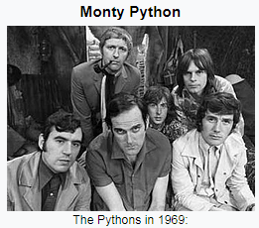
History
Invented by Guido van Rossum (https://gvanrossum.github.io/)
Why was it started?
Well put it simply, if you don’t like something then change it!
“What's in a name? That which we call a rose by any other name would smell as sweet”
“When he began implementing Python, Guido van Rossum was also reading the published scripts from “Monty Python’s Flying Circus”, a BBC comedy series from the 1970s. Van Rossum thought he needed a name that was short, unique, and slightly mysterious, so he decided to call the language Python.”
Interesting facts and discussions (https://docs.python.org/2/faq/general.html)

Slide 6
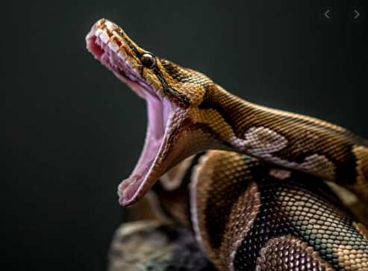
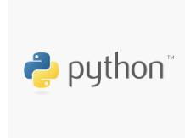
What is Python
Python is an interpreted, object-oriented, high-level programming language with dynamic semantics. Its high-level built in data structures, combined with dynamic typing and dynamic binding, make it very attractive for Rapid Application Development, as well as for use as a scripting or glue language to connect existing components together.
Python!
Well, not you!
Yaas!
Hello Python
Its Mouthful! Do not worry!

Slide 7
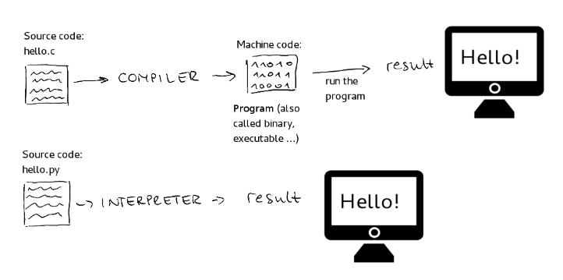
What is Python
Lets understand what each term means!
Interpreted
Processed run time by the interpreter, you don’t need to compile before executing
Pic Courtesy: https://medium.com/from-the-scratch/stop-it-there-are-no-compiled-and-interpreted-languages-512f84756664

Slide 8
What is Python
OOPs
Abstraction
Polymorphism
Inheritance
Encapsulation
Object Oriented Programming (OOPs)
1. Encapsulation (Its my private life, you do not have access).
encapsulation is protecting private data or hiding data from outside environment
2. Abstraction (Trust me, you do not need to know the details)
It means act of representing essential features without including background details and explanation
3. Polymorphism (Give me the Money! Oops Context)
polymorphism refers to a programming language's ability to process objects differently depending on their data type or class.
4. Inheritance (Its hereditary!)
Inheritance is a mechanism in which one class acquires the property of another class.
Notes:
Object-oriented programming (OOP) refers to a type of computer programming (software design) in which programmers define the data type of a data structure, and also the types of operations (functions) that can be applied to the data structure.
In this way, the data structure becomes an object that includes both data and functions. In addition, programmers can create relationships between one object and another. For example, objects can inherit characteristics from other object

Slide 9
What is Python
A collection of facts, such as numbers, words, measurements, observations or just descriptions of things.
Lets understand what each term means!
Built in data Structures
A data structure is a particular way of organizing data in a computer so that it can be used effectively.
Data

Slide 10
Different Types of Data Structures
Data Types
Primitive
(I am basic!)
Non-Primitive
(I am empty without primitive)
int
float
boolean
strings
tuple
list
dictionary
sets
I don’t change
I change
immutable
mutable
Notes:
Everything in python is an object

Slide 11
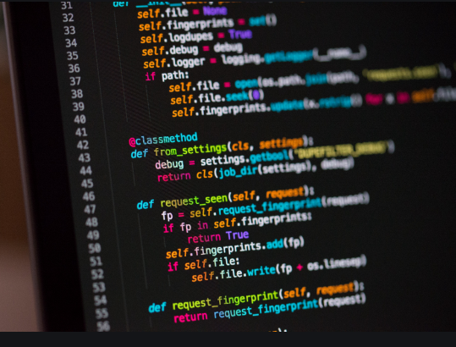
Lets Code!

Slide 12
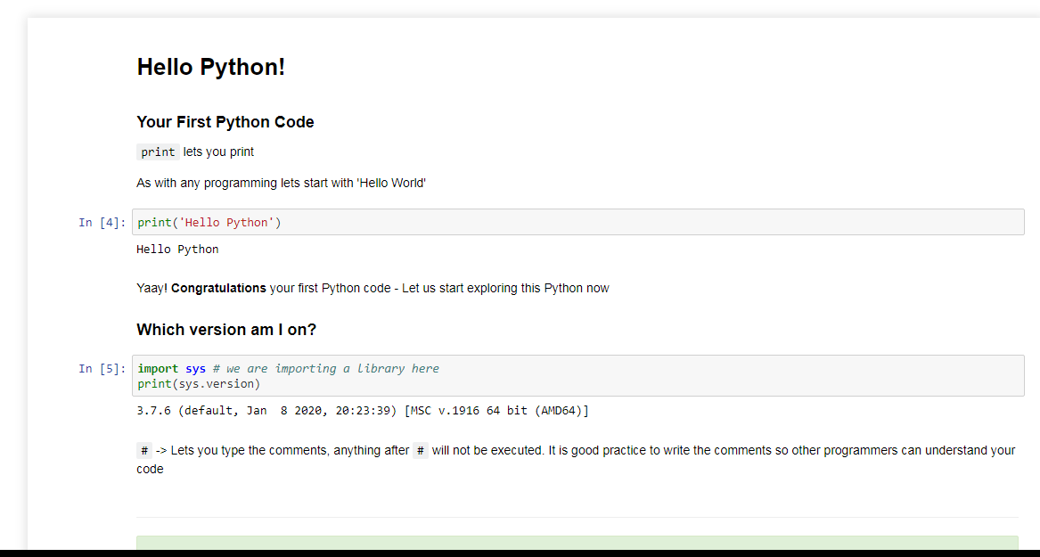
Hello Python!

Slide 13
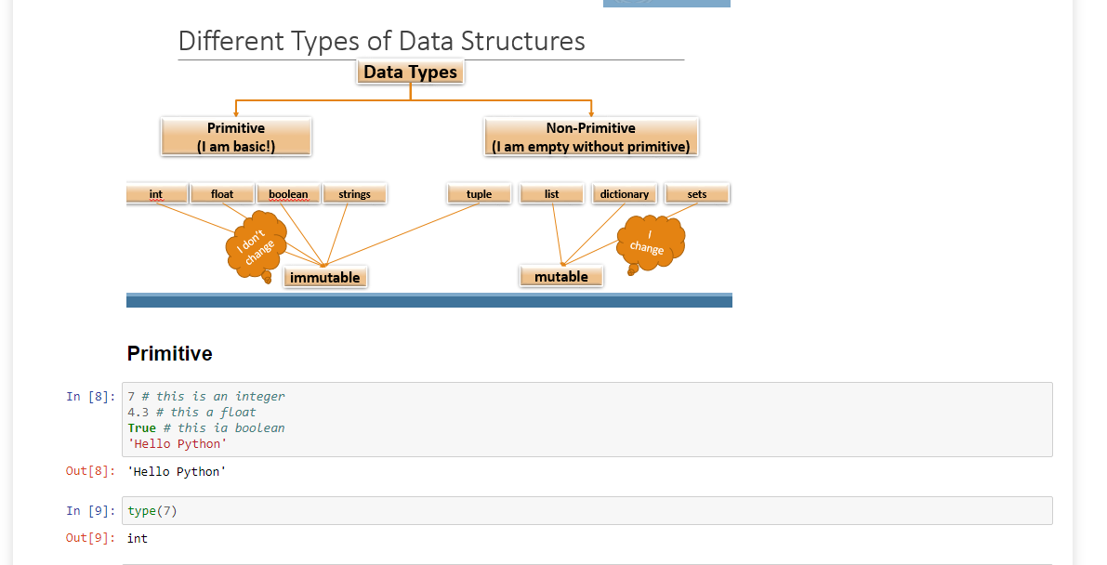
Primitive Data Types

Slide 14
Data Types
Int
Float
String
Variables
List

Slide 17
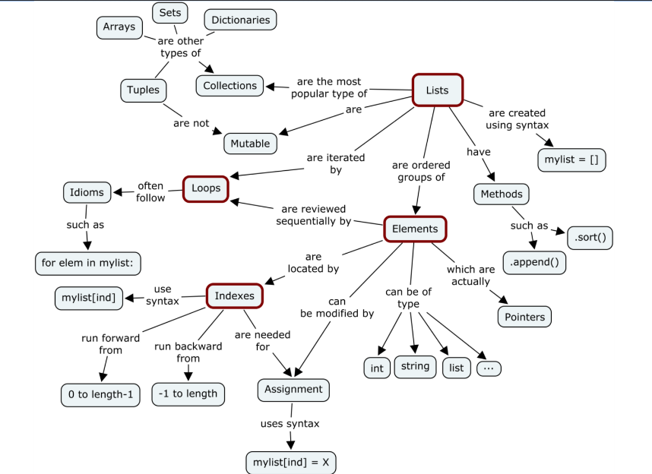
Pic Courtesy: Megha Mohan
Notes:
https://medium.com/@meghamohan/mutable-and-immutable-side-of-python-c2145cf72747

